Slide 1

University of Luxembourg
Sébastien De Landtsheer
Model Ensembling as a Tool to Form Interpretable Multi-Omic Predictors of Cancer Pharmacosensitivity
January 11th
DLSM seminar
Systems Biology Group

Slide 2
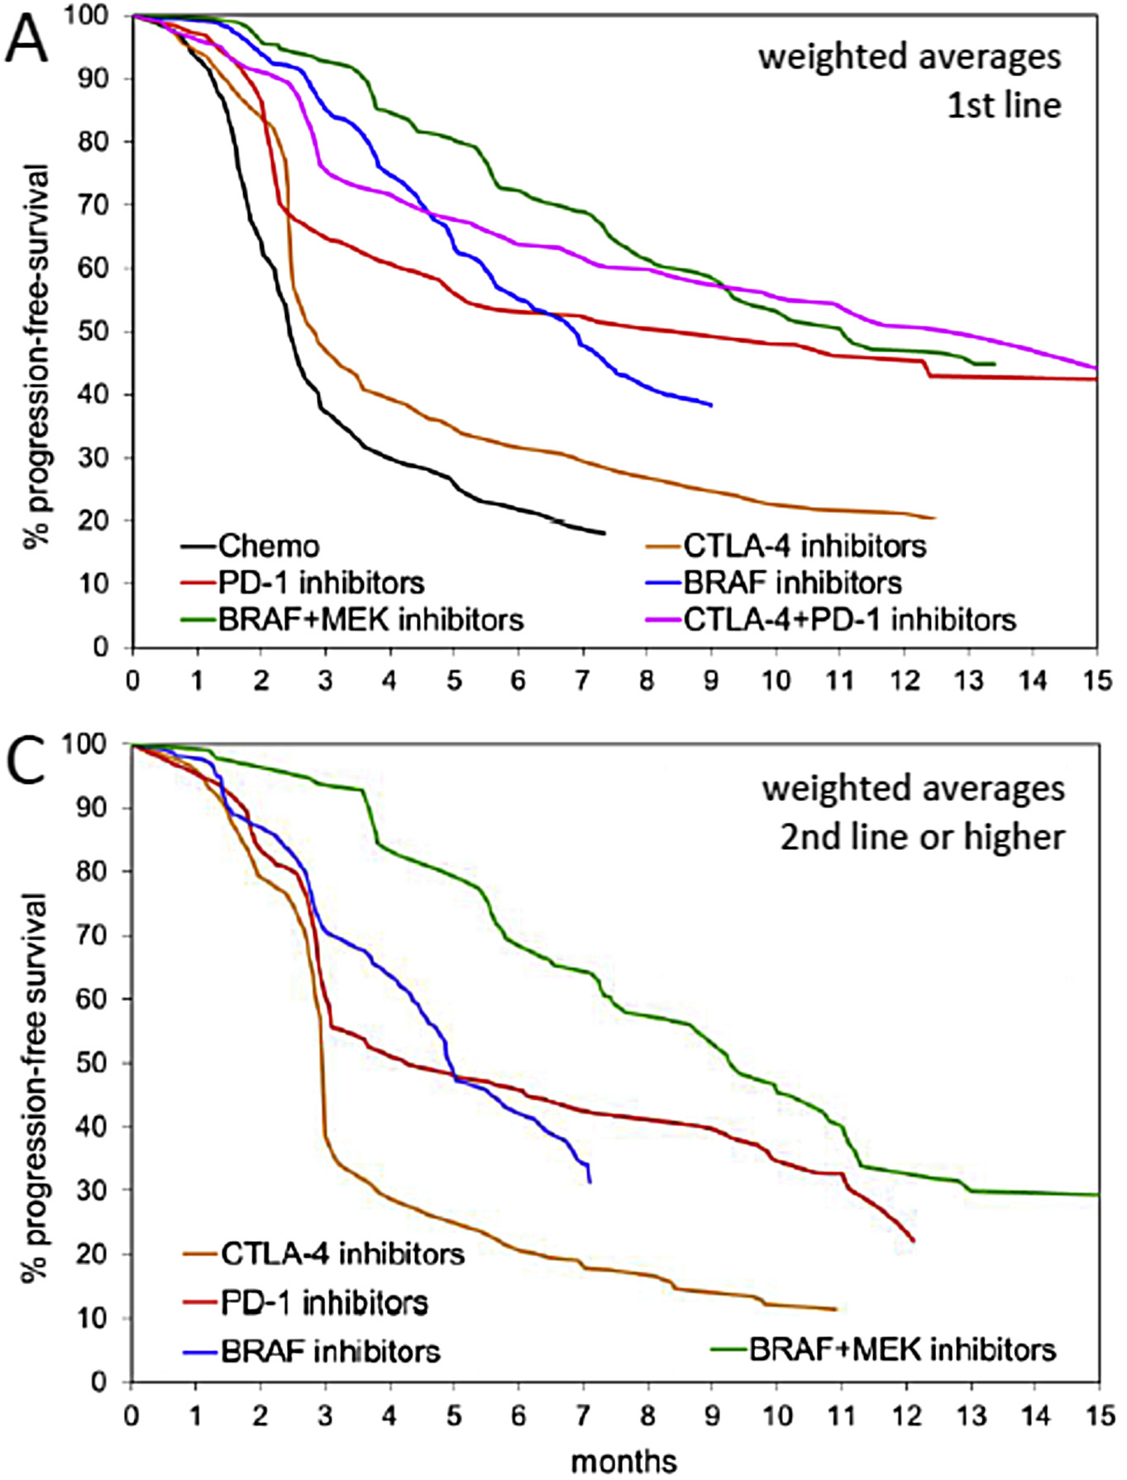
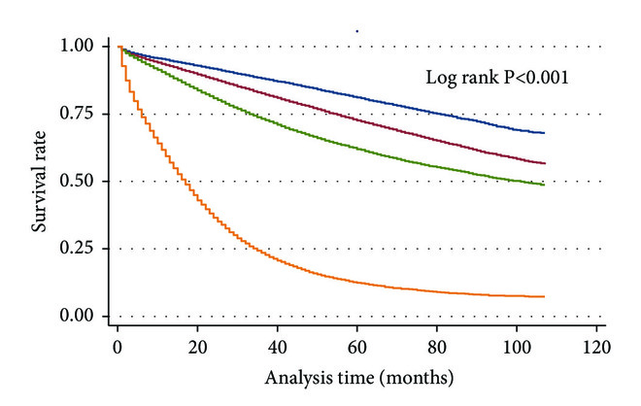
Patient responses to chemotherapies are highly variable
Melanoma
Colon carcinoma
stage I
stage II
stage III
stage IV
Unmet need for improvement of care of cancer patients
Nearly all biomarkers are genomic (BCR-ABL, EGFR, etc.)
Goal: develop predictors of drug response across omic types
Ugurel et al., Eur. J. Cancer (2016), 53; 125-34
Ulanja et al., J. Oncol. (2019):4315032

Slide 3

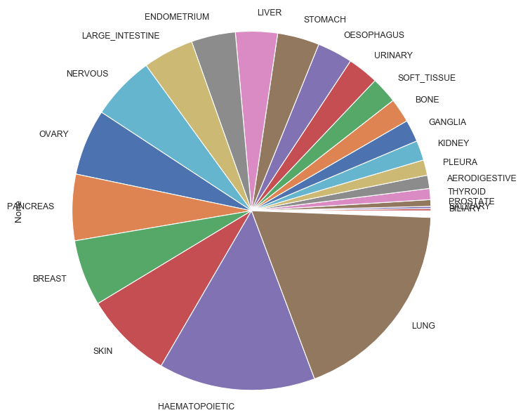
CCLE dataset: a large-scale screening effort provides multi-omic data
1000+ cell lines with near-complete multi-omics:
Genomics / Transcriptomics / Metabolomics / miRNA / RPPA and others
Dose-responses for 23 drugs
Barretina et al., Nature (2012), 483,7391; 603-7
Ghandi et al., Nature (2019), 569,7757; 503-8

Slide 4

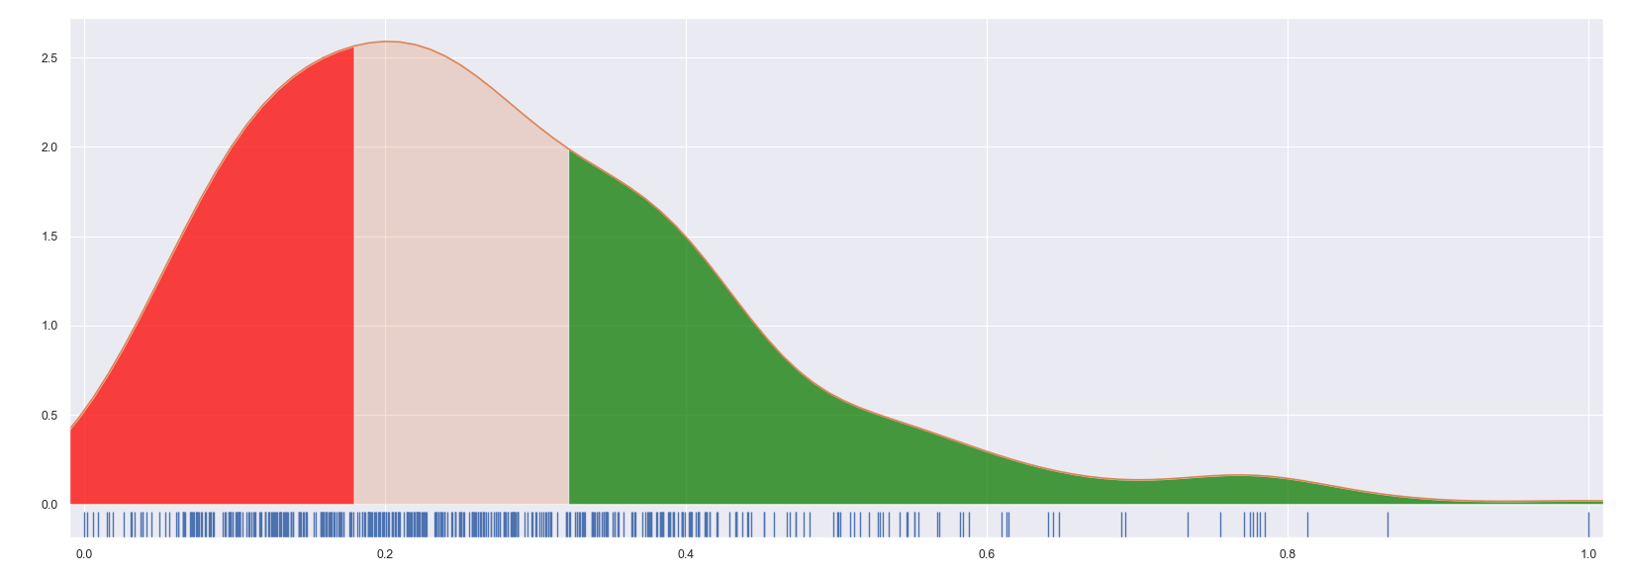
CCLE dataset: Activity Area as a proxy for cell line sensitivity
cell lines
‘Activity Area’ :
Area above the inhibition curve
Advantage vs IC₅₀: takes fractional killing into account
growth
IC₅₀
[inhibitor]
Distribution of normalized ActArea
Removed from analysis
Resistant
Sensitive
1/3 1/3 1/3

Slide 5
Pipeline : Ensemble of omic-specific models and their predictions
Omic Algorithm
Random Forest
Genomic
AdaBoost
Transcriptomic
XGBoost
Metabolomic
Extra-Trees
+
Proteomic
SVM
Pathway Analysis
Logistic
Tumor origin
Ridge
Elastic-Net

Slide 6
Pipeline : Ensemble of omic-specific models and their predictions
Omic Algorithm Prediction
Random Forest
P_{S}(RF)(omic)
Genomic
AdaBoost
P_{S}(Ada)(omic)
Transcriptomic
XGBoost
P_{S}(XGB)(omic)
Metabolomic
Extra-Trees
P_{S}(ET)(omic)
+
Proteomic
SVM
P_{S}(SVM)(omic)
Pathway Analysis
Logistic
P_{S}(Log)(omic)
Tumor origin
Ridge
P_{S}(R)(omic)
Elastic-Net
P_{S}(EN)(omic)

Slide 7
Pipeline : Ensemble of omic-specific models and their predictions
Omic Algorithm Prediction Late-stage integration
Random Forest
P_{S}(RF)(omic)
Genomic
AdaBoost
P_{S}(Ada)(omic)
Transcriptomic
XGBoost
P_{S}(XGB)(omic)
Metabolomic
Extra-Trees
P_{S}(ET)(omic)
Meta Classifier (Random Forest)
+
Proteomic
SVM
P_{S}(SVM)(omic)
Pathway Analysis
Logistic
P_{S}(Log)(omic)
Tumor origin
Ridge
P_{S}(R)(omic)
Elastic-Net
P_{S}(EN)(omic)

Slide 8
Validation procedure: nested cross-validation generates predictions for every sample while avoiding data leakage
transcriptomics
genomics
typing
pathways
proteomics
metabolomics
miRNomics
N samples
Current dataset
1) 10% Validation set is excluded

Slide 9
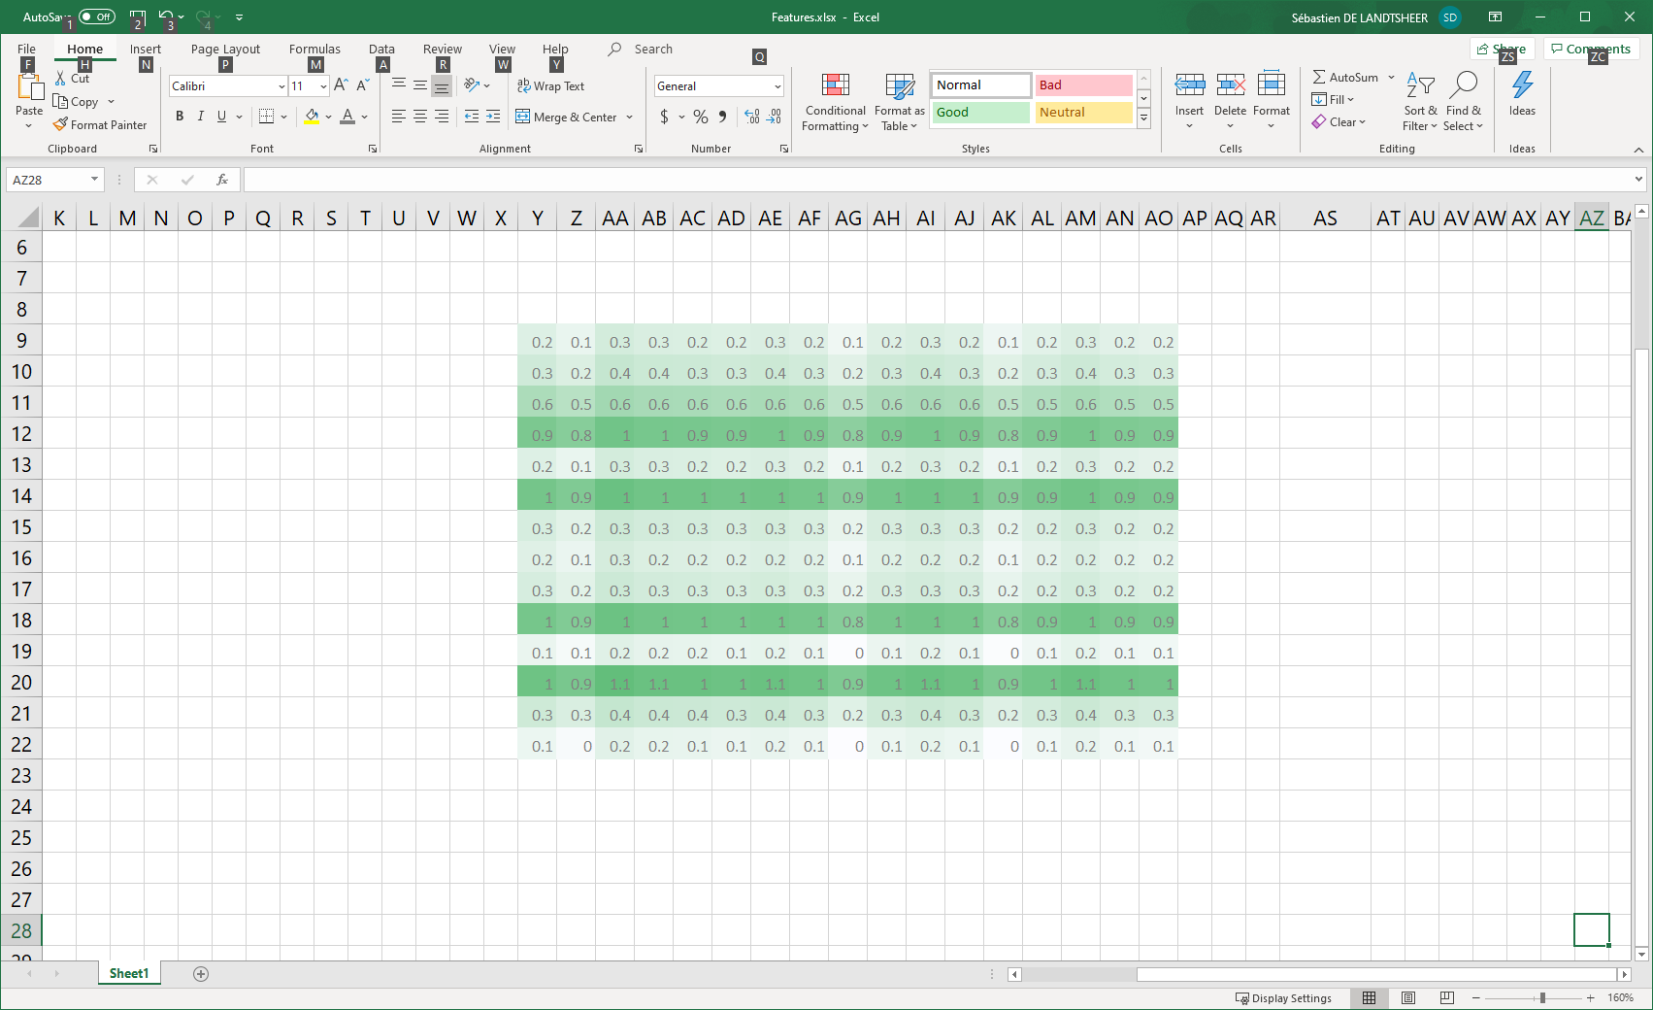
Validation procedure: nested cross-validation generates predictions for every sample while avoiding data leakage
transcriptomics
genomics
typing
pathways
proteomics
metabolomics
miRNomics
N samples
Current dataset
1) 10% Validation set is excluded
transcriptomics – model 1
transcriptomics – model 2
transcriptomics – model 3
genomics – model 1
genomics – model 2
genomics – model 3
typing – model 1
typing – model 2
typing – model 3
pathways – model 1
pathways – model 2
pathways – model 3
…
Repeat 10x
Model A1
Model A3
Model A2
2) 10% test set is excluded
3) each 1st-level model forms a prediction for the excluded test set

Slide 10
Validation procedure: nested cross-validation generates predictions for every sample while avoiding data leakage
transcriptomics
genomics
typing
pathways
proteomics
metabolomics
miRNomics
N samples
Current dataset
1) 10% Validation set is excluded
transcriptomics – model 1
transcriptomics – model 2
transcriptomics – model 3
genomics – model 1
genomics – model 2
genomics – model 3
typing – model 1
typing – model 2
typing – model 3
pathways – model 1
pathways – model 2
pathways – model 3
…
Repeat 10x
Model A1
Model A3
Model A2
2) 10% test set is excluded
3) each 1st-level model forms a prediction for the excluded test set
Repeat 10x
model B1
model B2
model B3
…
TP
4) The 2nd-level model tries to predict the validation set
Meta Model
FP

Slide 11
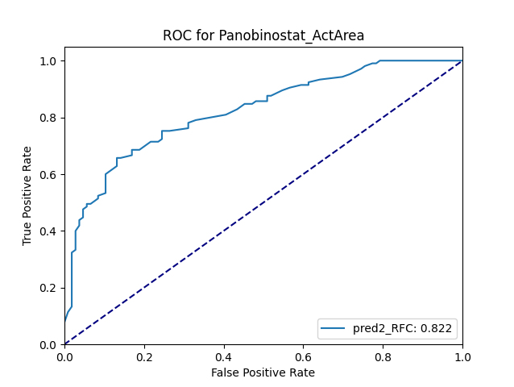
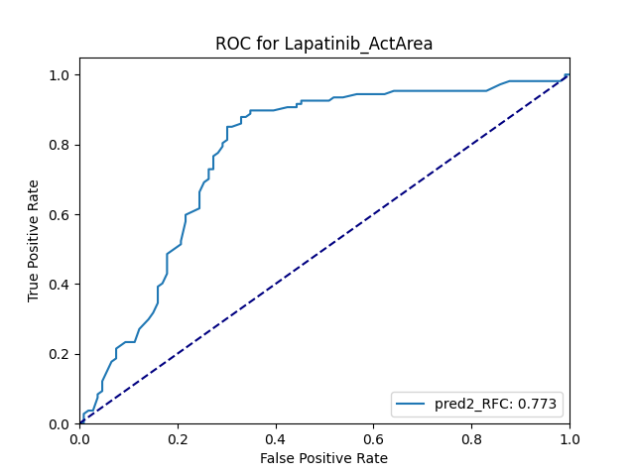

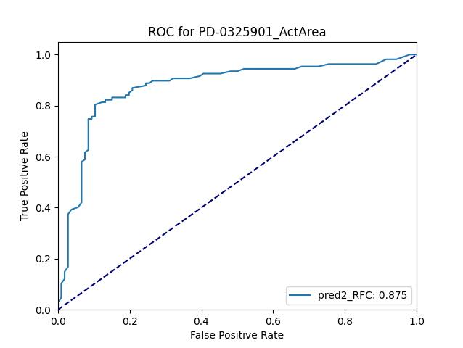
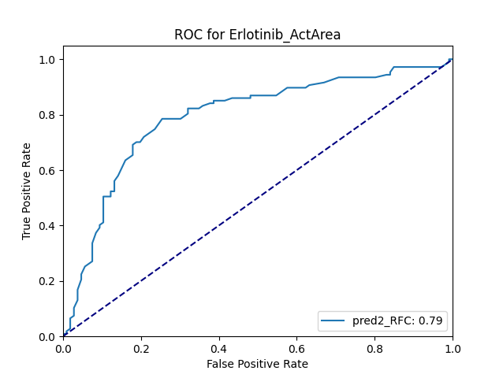
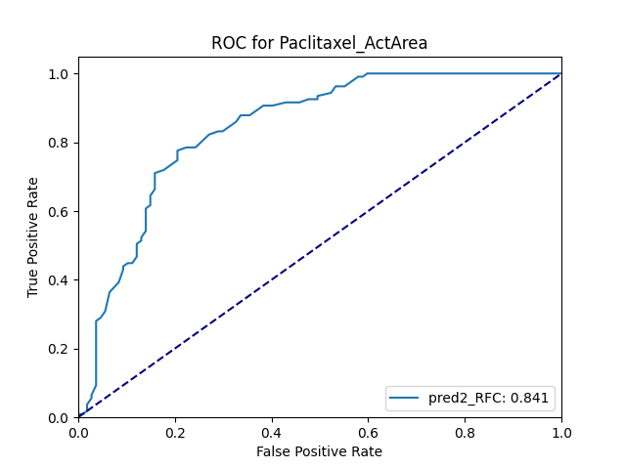
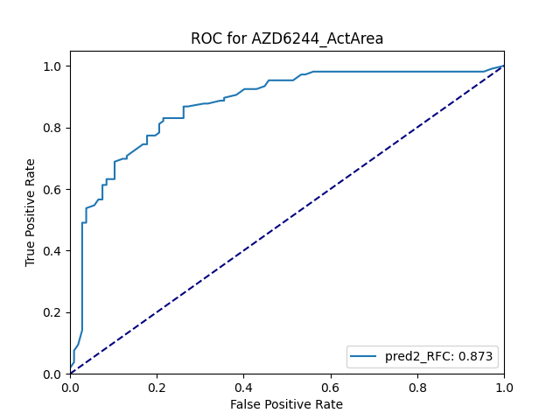
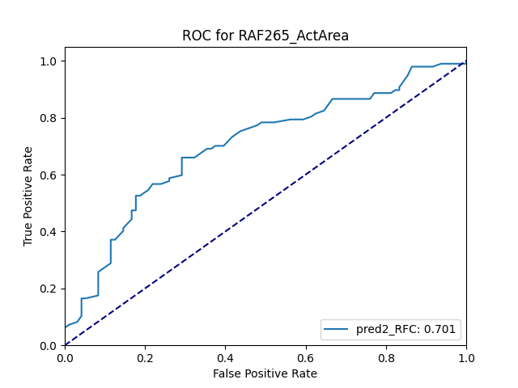
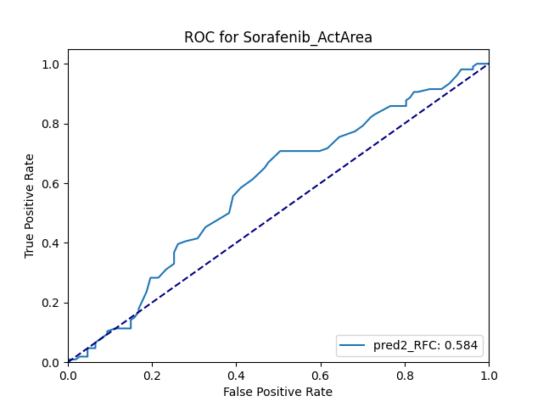

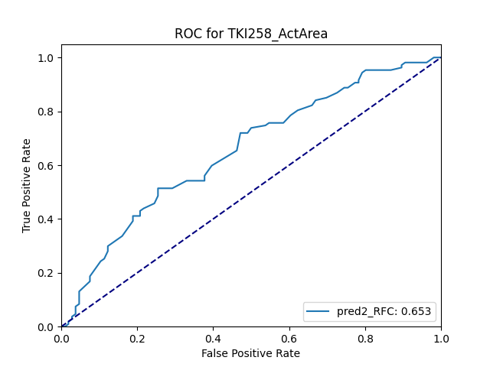

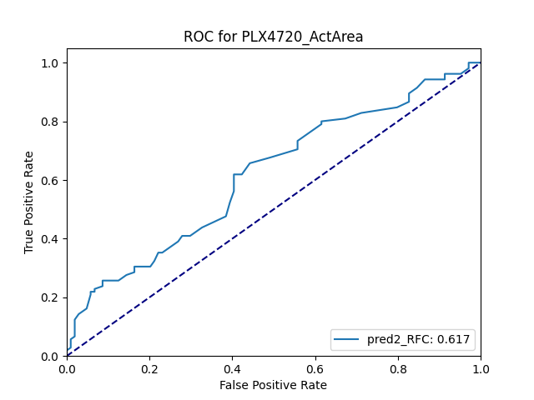
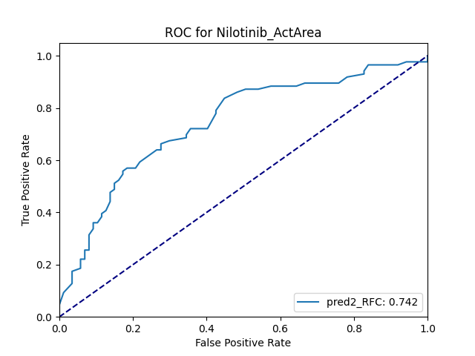
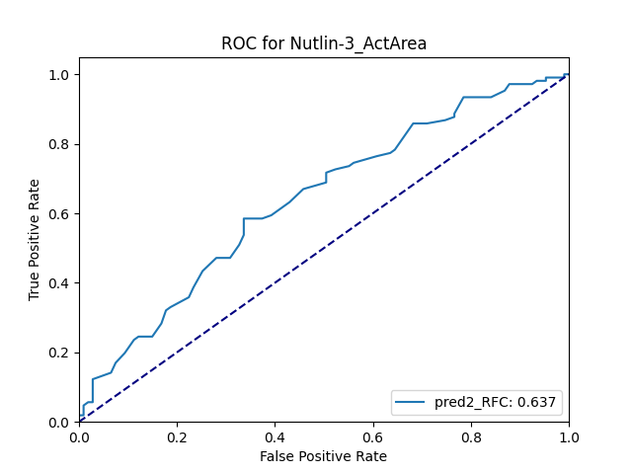
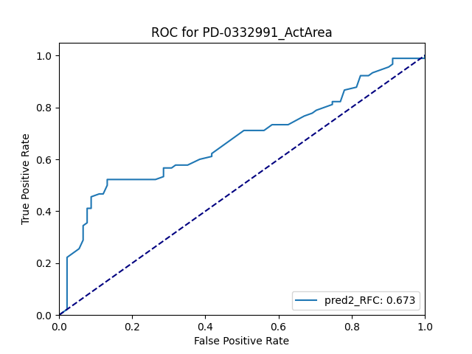
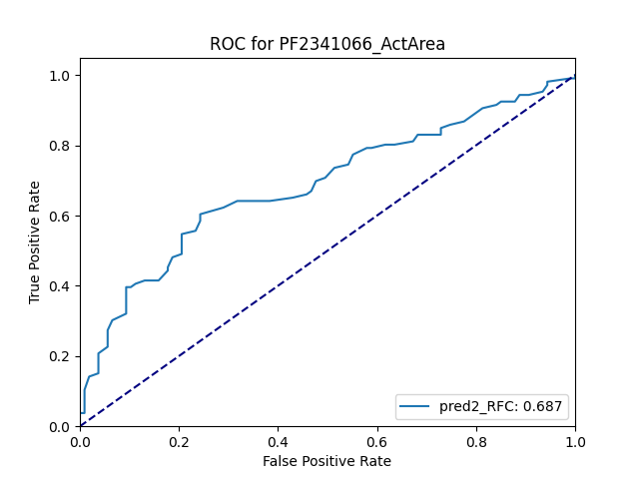
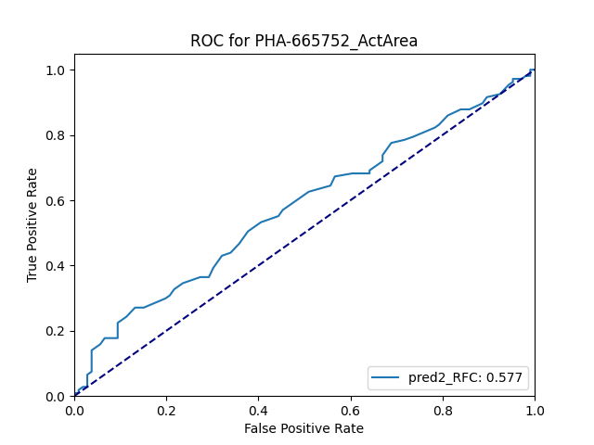
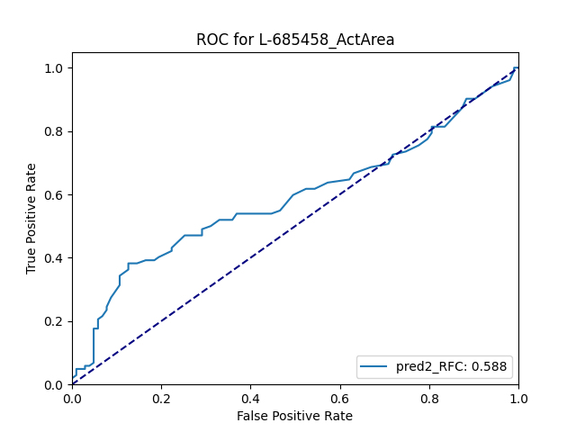
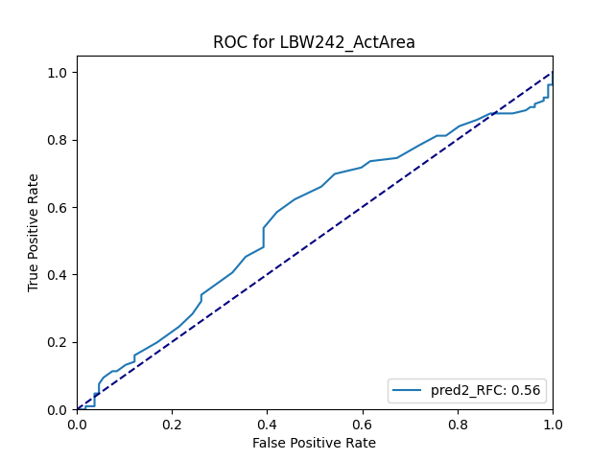

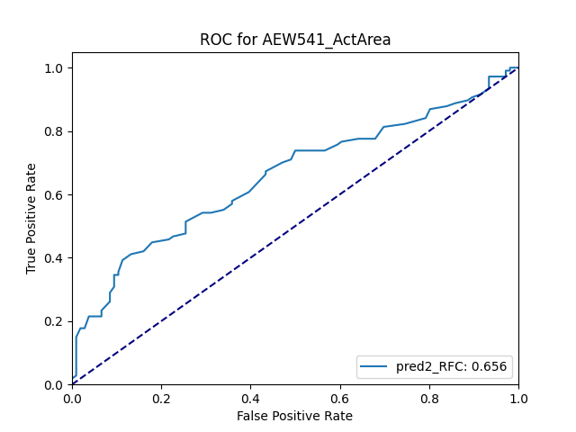

Mixed performance across 23 metaclassifiers

Slide 12
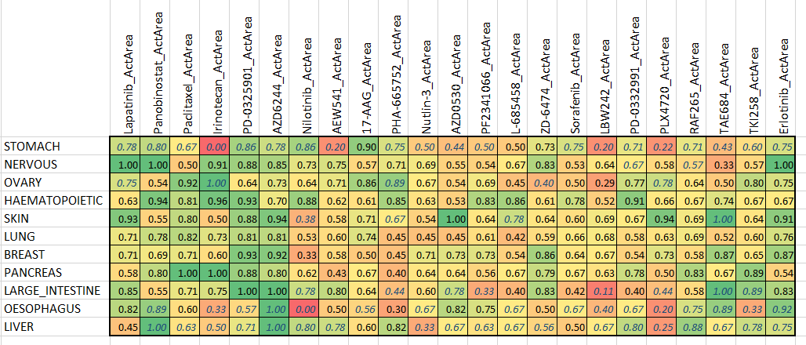
Accuracy varies across cell type and drugs
Italics: N < 10

Slide 13
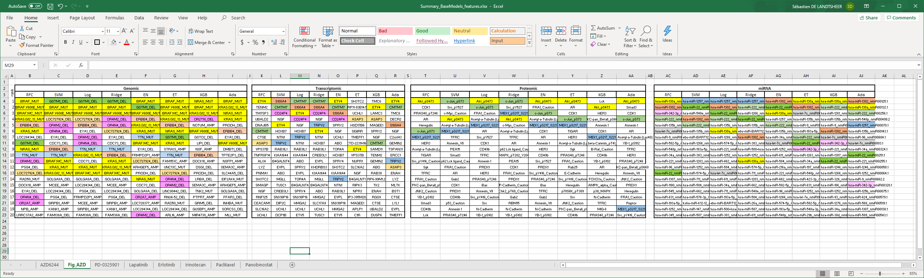
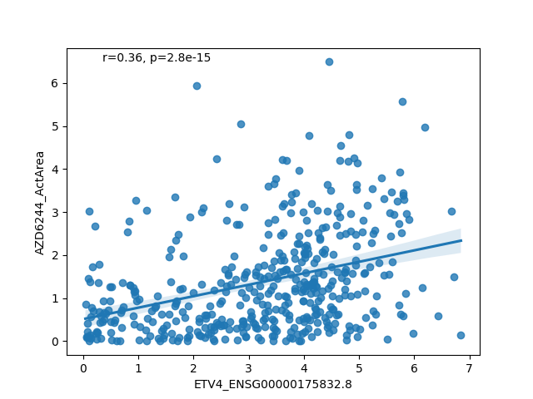
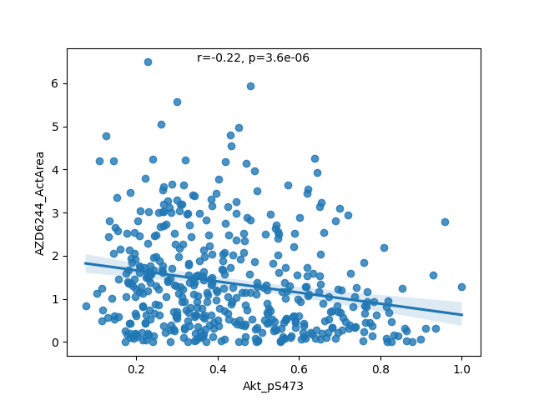
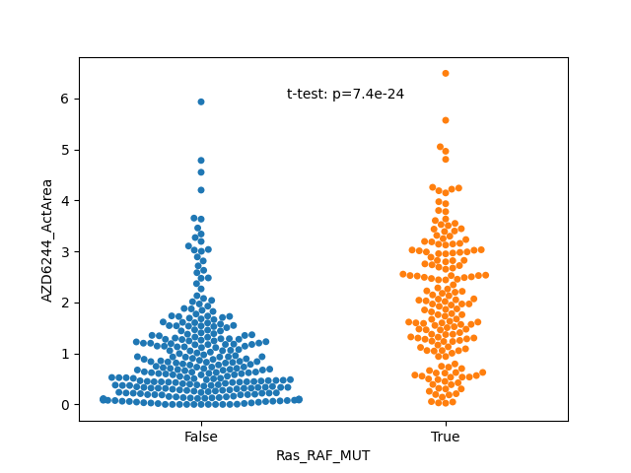
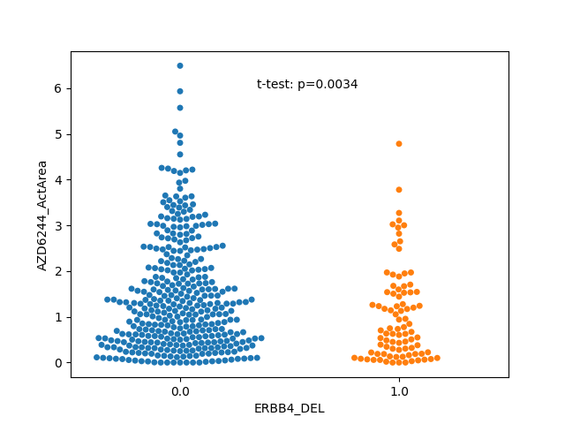
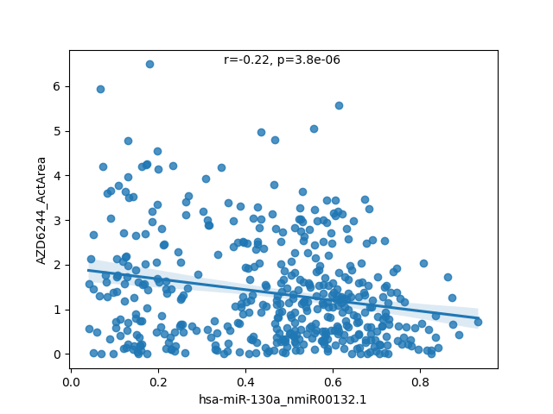
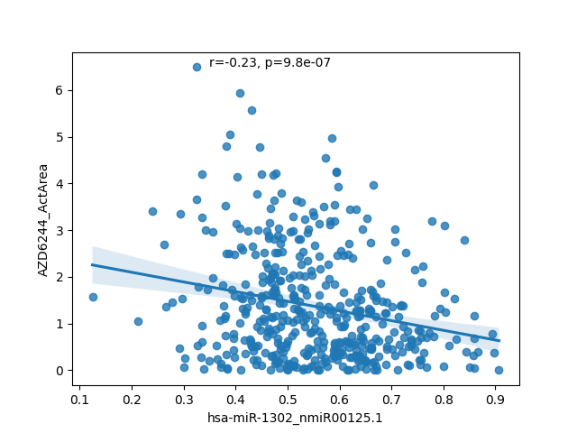
Model analysis points to specific markers of sensitivity 1: Selumetinib (MEK inhibitor)
Akt_p5473
ETV4 expression
WT Ras/RAF mutated
WT ERBB4 deleted
miR-130a expression
miR-1302 expression

Slide 14


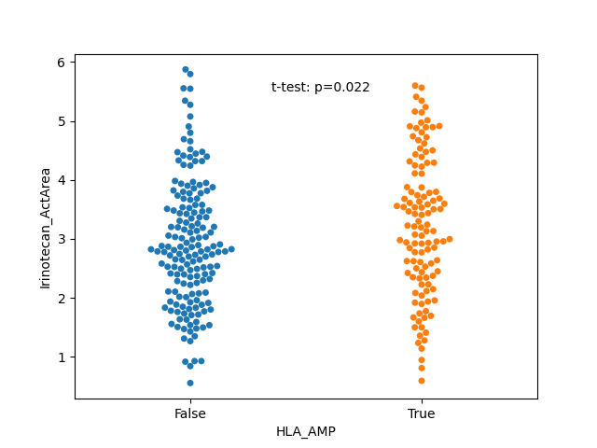
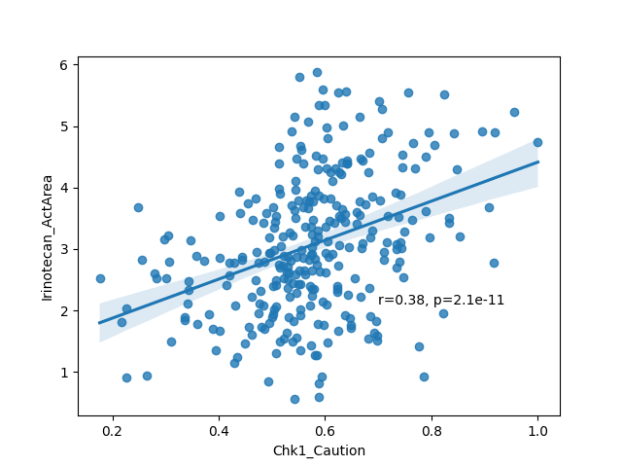

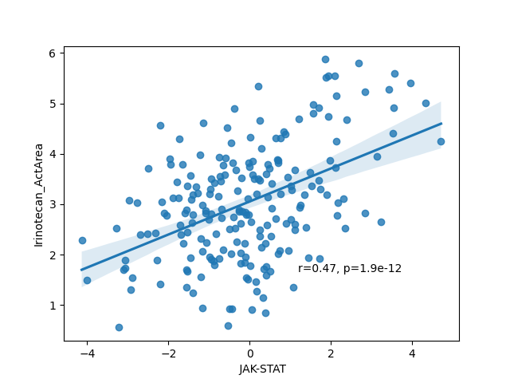
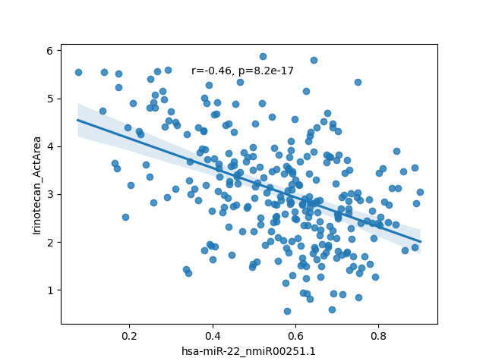
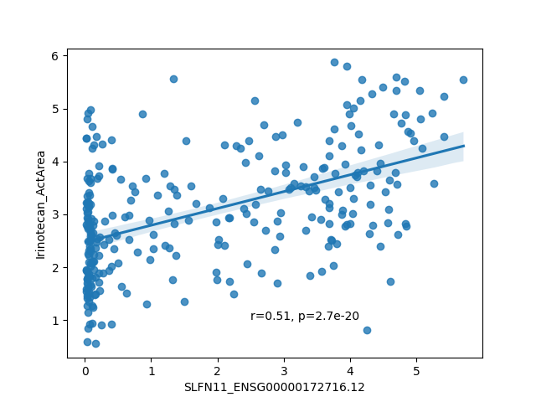
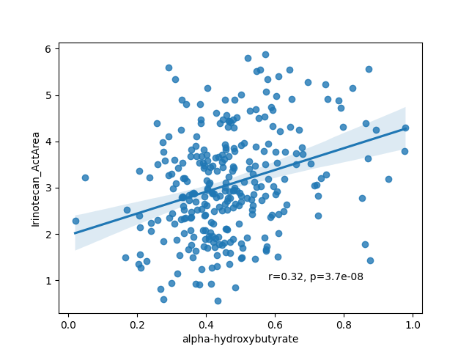
Model analysis points to specific markers of sensitivity 2: Irinotecan (Topoisomerase I inhibitor)
WT HLA amplified
Chk1 protein expression
JAK-STAT pathway activity
miR-22 expression
SLFN11 expression
Alpha-hydroxybutyrate

Slide 15
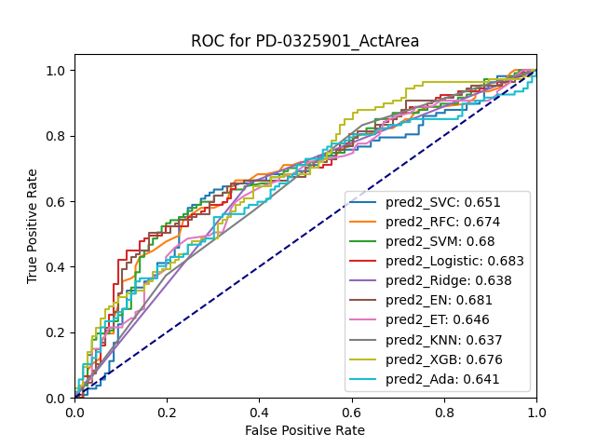
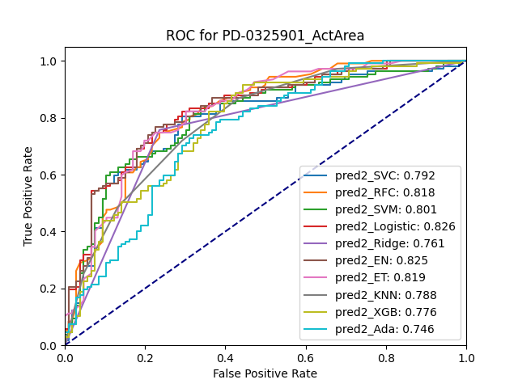
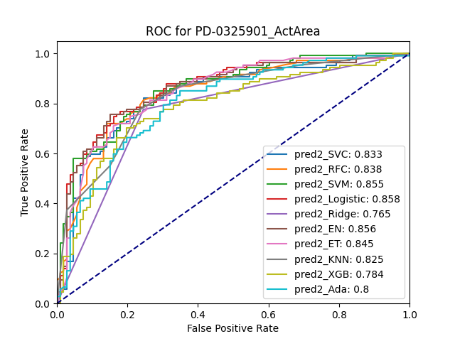
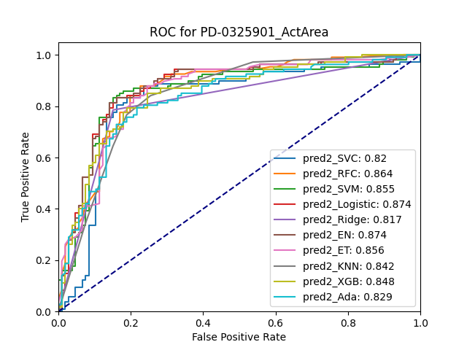
Comparing single-omic predictors for PD-0325901 (Mirdametinib, MEK inhibitor)
DNA only
miRNA only
proteomics only
RNA only

Slide 16
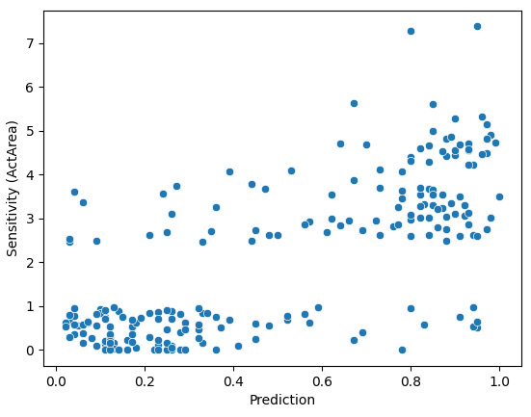

Example of evaluation of diagnostic utility: PD-0325901 (Mirdametinib, MEK inhibitor)
FN
TP
TN
FP
NPV: 82.7%
PPV: 85.3%

Slide 17




Conclusions and perspectives
Performance of predictors of sensitivity:
High (>75% ROCAUC): 7 drugs
Intermediate (>65% ROCAUC): 8 drugs
Low (<65% ROCAUC): 8 drugs
High accuracy for specific cancer types
Models point to both known and putative novel markers and/or targets
Analysis of the contribution of specific omic types -> model shrinking
=> deeper analysis to lead to fully explainable models
=> experimental validation: causality of markers
=> clinical evaluation on patient data (organoids)

Slide 18
THANK YOU FOR YOUR ATTENTION

